Slide 1
KEY CLUB JANUARY MEETING
Welcome Back!
First Meeting of Second Semester

Slide 2
PROBATION
If you are on probation, you have received an email.
You now need 25 POINTS to be eligible for awards.
SENIORS: If you are on probation, and fail to earn your 25 points by the end of this semester, you will NOT be receiving a graduation medal.
NON-SENIOR MEMBERS: If you are on probation, and fail to earn your 25 points by the end of this semester, you will NOT be receiving any awards.

Slide 3
DUES
If you have not paid your dues, this needs to be done so immediately in order to be considered for any medals (seniors) or awards. No dues = no awards.

Slide 4
MEETINGS
You MUST come to either our after school or morning meetings.
You are allowed to miss a maximum of ONE meeting.
If you by chance happen to miss a second meeting, you must email us with a valid excuse as to why.

Slide 5
CEREMONY
We will be hosting a ceremony to celebrate our newly chartered members.
When: Monday, February 4th at 6:00 PM (Members arrive at 5:30)
Where: AHS Auditorium
Why: To honor and celebrate the newly chartered members.
Who: Key Club Members and their parents are invited.
Dress Code: Formal
It is MANDATORY to attend. If you cannot, send us an email explaining why at least 48 hours in advance.
There will be a sign-up genius posted to bring food, (optional-for points)

Slide 6
OFFICER ELECTIONS
We encourage you to consider becoming an officer next year if you are interested! Application + 1 min speech + interview.
ALL positions are open!
President- oversees club, makes input decisions, prepares meetings
Vice President- aids President, helps promote events, contacts people
Secretary- tracks/keeps up with points, manages all emails & concerns
Editor/Webmaster- updates website/social media, submits monthly paper
Treasurer- handles all dues/fundraiser money, orders t-shirts & awards
APPLICATIONS WILL BE AVAILABLE SOON.

Slide 7
FUNDRAISERS
CHIPOTLE FUNDRAISER: SATURDAY, FEBRUARY 16TH, 5:00-9:00 PM

Slide 8
POINTS
NO POINT SHEET THIS SEMESTER.
To earn points: Send picture proof to our email if you go to one of our volunteering events, or fundraisers. State the number of hours you volunteered at a particular event to earn your points.
POINT SYSTEM: 1 point per hour you volunteer. If you volunteer for more than 3 hours, you start earning 2 points per hour. (Ex: 5 hrs = 7 pts)
Keep in mind, officers know how long the event lasts.
Providing an officer with a sign-up link to a volunteering event: 3 points
Sending pictures from the ceremony for us to post: 2 points

Slide 9
VOLUNTEERING OPPORTUNITIES
Four Corners Recreation Center Food Distribution 15700 Old Richmond Rd. Sugar Land, TX 77498
OAR Run for Autism- Sunday, January 20th https://www.volunteermatch.org/search/opp3055198.jsp
ONGOING:
http://sire-htec.org/volunteers/
http://www.secondmile.org/volunteer/
https://www.houstonfoodbank.org
Anything on AHS YES website

Slide 10
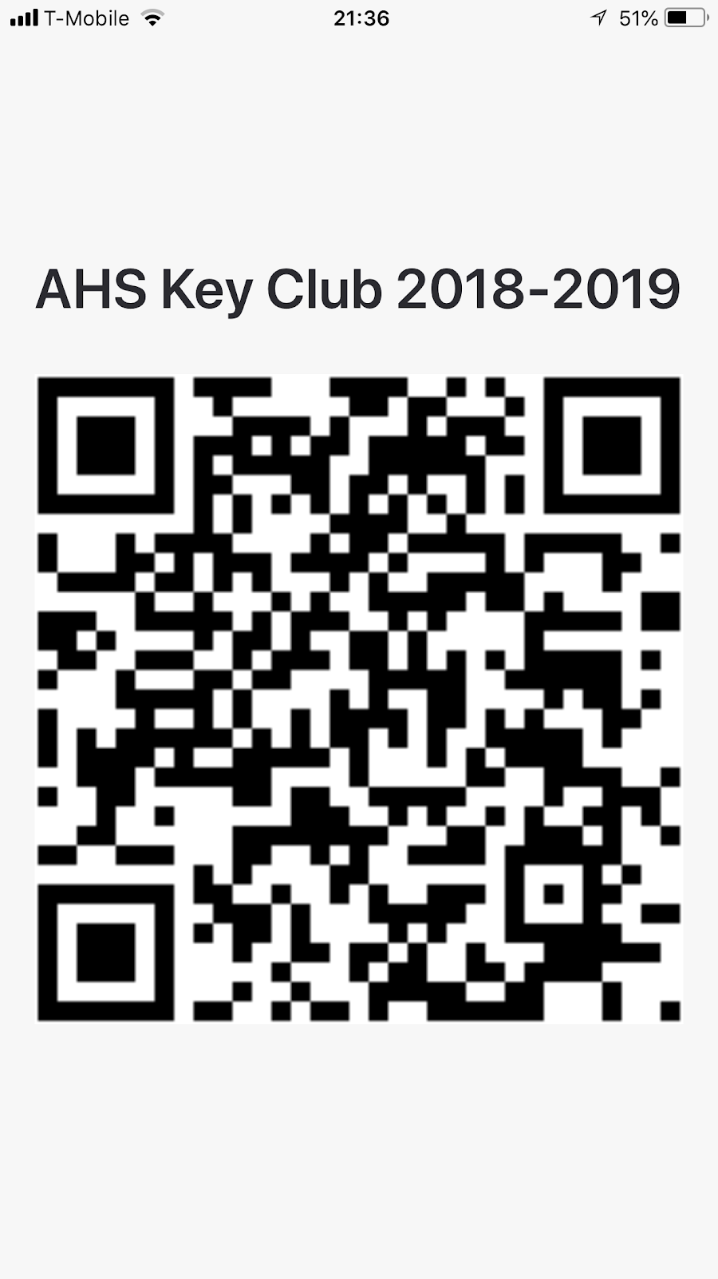
CONTACT INFO
Scan this QR Code to join the GroupMe
Website: www.sfakeyclub.weebly.com
Email: austinkeyclub@gmail.com
Instagram: @austinkeyclub
Facebook: Austin HS Key Club 2018-2019

Slide 11
RECAP
Pay Dues if you haven’t done so already.
Start earning your points! Regular Members: 15 POINTS. PROBATION: 25 POINTS.
Ceremony will be held on Monday, February 4th.
Consider becoming an officer! Applications will be available soon.
Fundraisers are approaching! Make sure to participate and stay involved. :)
Keep up with the volunteering opportunities for this month! You are able to earn points for our club and hours for other clubs when you use our opps.

